Slide 1
Automated Tracing, Debugging and Repairing Data-Centric Programs
Diptikalyan Saha
IBM Research, India

Slide 2
Data-Centric Programs
Programs that have SQL-like constructs to interact with databases
  ABAP (used in SAP-ERP), COBOL, PL/SQL
  Have both imperative and declarative syntax
Example: ABAP Report program
1
2
3
4
5
6
7
8
9
10
11
12
13
14
15
16
17
18
Select CustId ItemId Price Year from OrderTab into itab.
Select CustId Discount Year from DiscountTab into stab.
Sort itab by CustId, ItemId.
Delete from itab where Year <= CurrentYear – 2.
Loop at itab into wa.
At new CustId.
amount=0.
Endat.
amount = amount + wa.Price.
read stab into fa where CustId = wa.CustId.
if sy.subrc = 0.
  amount = amount - fa.Discount.
endif.
At end of CustId.
write wa.CustId, amount.
Endat.
E Endloop.
OrderTab
CustId | ItemId | Price | Year
1 | Item1 | 10.0 | 2010
1 | Item2 | 10.0 | 2011
2 | Item3 | 10.0 | 2011
For each customer
DiscountTab
Adds the price for each
item
CustId | Discount | Year
1 | 2.0 | 2010
2 | 3.0 | 2011
Subtracts the
Discount for
each item
Output
CustId | Amount
1 | 16.0
2 | 7.0
Generates output for
each customer

Slide 3
Motivation
Production failures are reported as tickets
  Bugs need to be solved urgently
  Code has been tested, errors are mostly corner cases
Challenges
  Handle both imperative and declarative syntax
  Data driven
    Behavior of the database commands is dependent on the underlying data
  Different types of problems
    Incorrect value
    Missing data
    Unwanted data

Slide 4
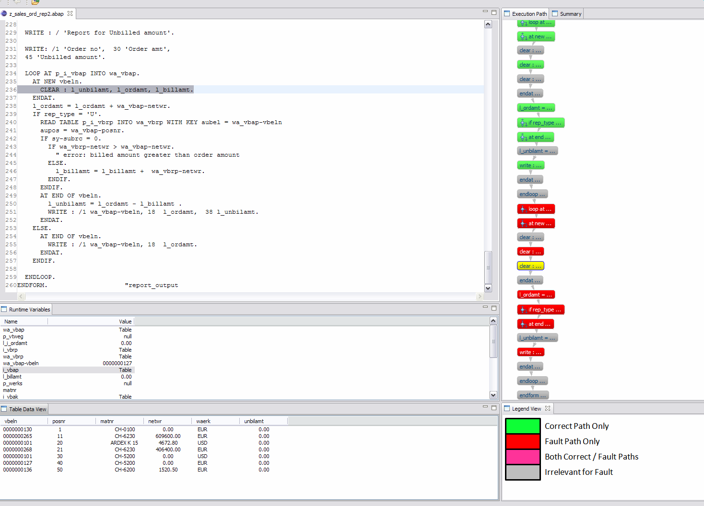
Fault Localization of SAP-ABAP Programs
Contributions:
  Fault Localization of Data-Centric Programs (FSE’11)
  Distributed Program Tracing (FSE’13)
  Data-Guided Repair of Selection Statements (ICSE’14)
  P3: Partitioned Program Profiling (FSE’15)
  Gramin: a system for incremental learning of programming language grammars. (ISEC’11)
  A framework for analyzing programs written in proprietary languages. (OOPSLA Onward’11)

Slide 5

Today’s Menu
Starters
  Tracing
  Profiling
Dessert
  Fault Localization
  Repair

Slide 6
Trace
Input: 6, 4
1
2
3
4
7
2
3
5
6
7
2
8
1
2
3
4
5
6
7
8
read a, b
while a ≠ b
if a > b
a := a − b
else
b := b − a
endif
write a

Slide 7
A Trivial Technique for Program Tracing
log 1
read a, b
log 2
while a ≠ b
log 3
if a > b
log 4
a := a − b
else
log 5,6
b := b − a
endif
log 7,2
Log 8
write a
1
2
3
4
5
6
7
8
read a, b
while a ≠ b
if a > b
a := a − b
else
b := b − a
endif
write a

Slide 8
Program Tracing: Techniques and Challenges
Instrumentation of source code
  e.g. Emma, InsECTJ, Purify
Non-instrumentation of source code or lower level code in production environments e.g. SAP-ERP
Instrumentation of low level code
  e.g. Pin, WET
Collection overhead
Debugger based collection
  Gupta et al. TOSEM’97,
  Xu et al. SCAM’02
Limited monitoring
  Breakpoint limit imposed by debugger
Notes:
Instrumentation of source code or low-level code are common techniques to insert witnesses into program. At runtime this witnesses produce partial paths from which paths are derived.
However, in industry setting such instrumentation is not allowed as it may change the intended behavior of the software. Debugger based collection is useful in this scenario.
Both instrumentation and debugger based collection suffer from collection overhead. And in some case there may be limit in the number of witnesses.

Slide 9
Related Work: Taming Collection Overhead by Minimizing Witnesses
entry
entry
Non-witnessed vertices/edges
entry
entry
1
Witnessed vertices/edges
b1
b1
Breaking a directed
cycle
b1
The Edge Witnesses
break all directed cycles
and diamonds
4
b2
b2
b2
2
2
b1
1
b4
b4
b3
b3
b4
b3
b2
b5
b5
1
b5
3
Breaking a diamond.
b4
b7
b7
b6
b6
b7
b6
1
b5
3
b5
b8
b8
b6
b8
b7
b6
4
exit
exit
exit
b8
b8
Ewit: Optimal
Ball-Larus’94
Vwit: Predicate Targets
Vwit: Basic Blocks

Slide 10
Distributed Program Tracing
entry
(input)
entry
entry
~
~
Distribute witnesses across
multiple program executions
~
~
b1
b1
Profile 1
b1
Profile 2
b2
b2
b2
Parallel execution
Faster Collection
b4
b4
b3
b4
b3
b3
Profile size
Limited monitoring
b5
b5
b5
b3
b4
b6
b6
b7
b6
b7
b7
b8
b8
b8
b7
b6
exit
exit
exit
~
~
Run on
Run on
~
~
Partial paths
b7
b6
b3
b4
Full Path
entry
b1
b2
b3
b5
b7
b1
b2
b4
b5
b6
b1
exit

Slide 11
Divide-and-Conquer
Divide (How do we generate profiles)
Optimally divide for Parallel Collection
Conquer (How do we construct final path)
A profile distribution is realizable if it is possible to construct any trace from the corresponding partial traces.

Slide 12
Arbitrary Distribution cannot guarantee Realizability
entry
entry
b1
b1
b2
b2
b3
b4
b4
b3
b4
b3
b5
b5
b7
b6
b7
b6
b7
b6
b8
b8
exit
exit
Partial paths
b3
b7
b4
b6
Full Path
entry
b1
b2
b3/b4?

Slide 13
Realizable Distribution
entry
entry
entry
entry
1. For each diamond there exists at least one
profile which breaks the diamond and all
directed cycles passing through it.
b1
b1
b1
b1
b2
Necessary and Sufficient condition for realizable profile distribution
b2
b2
b2
2
2. All directed cycles are broken
1
2
b4
b4
b4
b3
b4
b3
b3
b3
b5
b5
b5
b5
b6
The algorithm distributes the diamonds
and directed-cycles-without-diamonds of
the program’s ICFG across profiles to break.
Breaks diamonds and cycles in a profile
by optimal set of witnesses
(For edge-witness - Ball-Larus)
(For vertex-witness – Our extension to Ball-Larus’)
b6
b6
b7
b6
b7
b7
b7
b8
b8
b8
b8
exit
exit
exit
exit

Slide 14


Effective Parallel Distribution
Time
Witness Hits
Time taken/Hits
T1
T2
Total time for collection =
Max(T1,T2)
For optimal time for collection across machines minimize Max(T1,T2)
Approximate hits at runtime by profile weights.
(Approximation 1)

Slide 15
Optimal Parallel Distribution
Optimal parallel distribution problem with unbounded (and bounded) profile size is NP-Complete
  Reduction from Multiprocessor Scheduling problem
    Given m identical machines M1, . . . , Mm and n jobs J1, J2, . . . , Jn. Job Ji has a processing time pi ≥ 0 and the goal is to assign jobs to the machines so as to minimize the maximum total processing across machines
Greedy approximation algorithms
  (2-1/m approximation algorithm)
    For each job, assign it to a machine with least current load
  4/3 - 1/(3m) approximation algorithm
    Sort all jobs based on processing time
    For each job in descending order, assign it to a machine with least current load
(Approximation 2)

Slide 16
Distribution Strategies
entry
b1
entry
entry
entry
entry
b2
b1
b1
b1
b1
b2
b2
b2
b2
b3
b4
b3
b4
b3
b4
b3
b4
b3
b4
b5
b5
b5
b5
b5
b6
b7
b6
b7
b6
b7
b6
b7
b6
b7
b8
b8
b8
b8
b8
b9
b10
b9
b10
b9
b10
b9
b10
b9
b10
b11
b11
b11
b11
b11
exit
exit
exit
exit
entry
exit
b1
Witness-optimizable diamonds
b2
b3
b4
Combination of multiple diamonds and directed cycles to cover in a single profile can be beneficial to reduce the profile weight.
b5
b6
b7
b8
b9
b10
b11
exit

Slide 17
Distribution Strategies
Fine-grained distribution strategy
  Job = diamond / directed-cycle-without-diamond
Function-wise grouping strategy
  Job = diamonds and directed cycles in a function
Optimized grouping strategy
  Job = combining potentially witness-optimizable diamonds
Combining diamonds/cycles in a job is
Good:
Witness Optimizable diamonds
Bad:
Lesser job weights facilitate even distribution
(Approximation 3)

Slide 18
Path Reconstruction
Reconstructed Path
Profile Distribution
b0
b0
b0
entry
b3
b1
b1
b1
b3
b3
entry
b0
b2
b2
b2
b3
b4
b4
b4
b0
b3
b4
b1, b3
b1, b2
b2, b3
b0
b1
b2
b3
b1
b3
b1
b3
b1
b4
b4
b1
b2
b2
exit
b0
b2
b2
b4
b0
exit

Slide 19
Tracing ABAP Programs using Breakpoints: Optimal Vertex Witnesses
entry
entry
b1
b1
b2
b2
b3
b3
b4
b4
b5
b6
b5
b6
b7
b7
exit
exit
Edge Witness
Vertex Witness

Slide 20
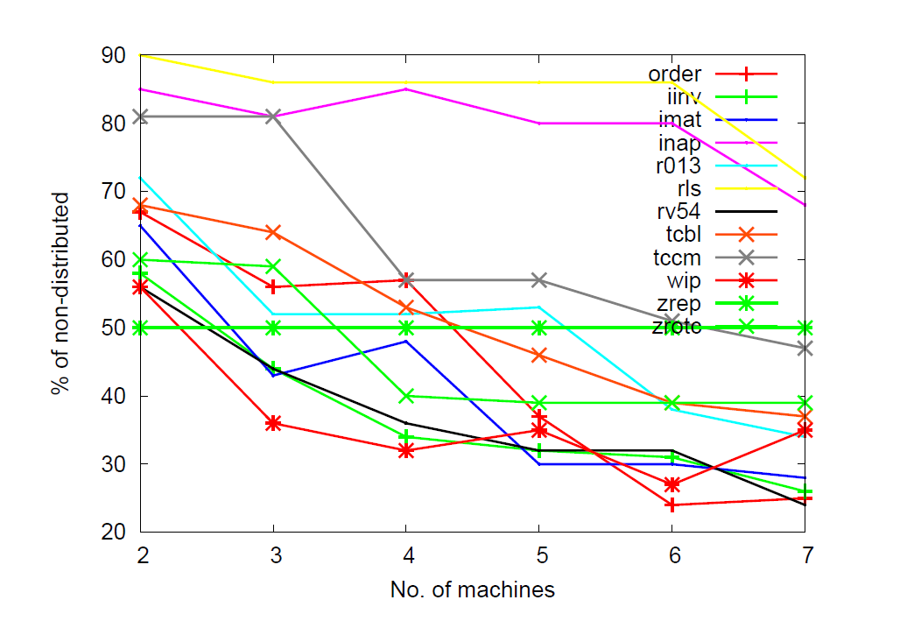
Experimental Results: Cost of Collection vs. Number of Machines
Experiments with 12 ABAP programs
Summary:
Average benefit vs. machine
62, 49, 44, 38, 32, 31
(2 to 7 machines)
For rls, inap, zrep –
no reduction as profile
did not follow the trace
(Approximation 1)

Slide 21
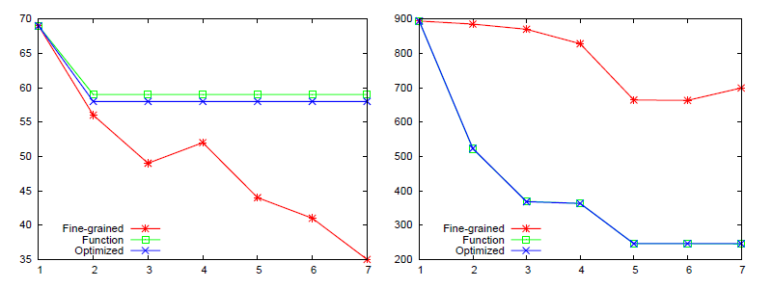
Comparing Parallel Distribution Strategies
inap
order
Hits
Machines
Summary:
For Trace profile
a) optimized grouping is better than function-wise grouping
b) fine-grained wins 6/12 cases, with lesser number of functions.

Slide 22
Recap
Assumptions
Summary
  Divide and Conquer based program tracing for single threaded programs
  Necessary and sufficient condition to guarantee realizability
  Effective distribution strategy for parallel distribution
    Multiple machines – with or without limit
      Static distribution (all witnesses are pre-assigned in queues)
      NP-Completeness
  An algorithm to convert Ball-Larus’ edge-optimal solution to node-optimal solution
Extensions: Dynamic Scheduling strategies

Slide 23
Path Profiling
Determines how many times each acyclic path in a procedure executes [intra-procedural/acyclic version]
  Ball & Larus (MICRO’96)
    Assigns integer values to edges such
    that no two acyclic paths compute the
    same path sum.
Overhead
  Average overhead 31% (6 to 97%) [Ball-Larus]
  Average runtime overhead of 50% with worst case overhead of 132% [Vaswani et al.]
Solution proposed
  Use of parallelization to distribute the overheads into multiple cores
b1
0
2
b2
b3
0
b4
1
b5
b6
b7

Slide 24
Naive Parallelization: Parallel Ball-Larus (PBL)
Procedures
  Create multiple copies of the program each profiling (disjoint) subset of procedures. Run each copy in different core, in parallel with same input
Cores
Challenge: Even distribution of profiling overhead to machines as overall overhead is determined by the slowest machine

Slide 25
PBL Drawback: Uneven distribution and New Idea

Slide 26
Partitioned Path Profiling: Goal

Slide 27

P3: Overview and Challenges
Profitable
Procedure
Selection
  C1: How do we select a procedure for partitioning its paths
  C2: Precise & Efficient profiling of a subset of intra-procedural paths
  C3: How to form the path partition of a procedure
Path Selection
Distribution
  C4: How to distribute the profiles for effective load balancing

Slide 28
C2: Precise & Efficient Profiling of Subset of
Intra-Procedural Paths
I : Interesting Paths
I : Un-Interesting Paths
Preciseness: pid(i) ≠ pid (j) where i, j Є I
pid(i) ≠ pid (j) where i Є I, j Є
I
Efficiency: Number of probes is preferably lesser than the number of probes in BL

Slide 29
Selective Path Profiling (PASTE’02)
SPP has three steps
  Labeling: Process uninteresting edges (no interesting paths passing through these edges) before interesting edges
a
a
0
0
Nb
Nb+Nc
Nb
Nb+Nc
b
c
d
b
c
d
Nb
Nc
Nd
Nb
Nc
Nd
Ball-Larus’ Labelling
SPP Labelling

Slide 30
Selective Path Profiling (PASTE’02)
SPP has three steps
  Labeling: Process uninteresting edges (no interesting paths passing through these edges) before interesting edges
  Propagates label of single incoming edge of a node to its outgoing edges
  Remove labels from uninteresting edges (absorption)
entry
entry
1
v1
v1
5
0
v2
v2
1
4
v12
10
v12
6
2
v4
v13
v14
v4
v13
v14
v5
v6
2
v15
v5
v6
v15
v0
v3
v0
v3
4
2
1
v7
v16
v17
v7
v16
v17
v8
v9
1
v18
v8
v9
2
v18
1
1
v10
v19
v20
v10
v19
v20
v11
v21
v11
1
v21
v22
v22
Labeling
exit
Propagation
exit

Slide 31
Motivation: Precise Selective Path Profiling
entry
entry
1
v1
a
v1
8
v2
0
v2
10
v12
0
1
4
v12
Nb
Nb+Nc
v4
v13
v14
2
v4
v13
v14
v6
v15
b
c
v6
2
d
v15
v0
v5
2
v0
v5
v3
4
v7
v16
v17
v3
1
v7
v16
v17
v8
v9
2
v18
v8
v9
1
v18
1
v10
v19
v20
v10
v19
v20
v11
1
v21
v11
v21
v22
Nb
Nc
v22
Nd
exit
exit
Dotted paths have same id
Dotted paths have different ids
Violation of Preciseness criteria:
pid(i) ≠ pid (j) where i Є I, j Є
Key Observation:
The order of interesting edges are important
I

Slide 32
PSPP Algorithm
pid(p, v), partial identifier, denotes the sum of edge labels of the suffix suff(p, v) of a path p from vertex v onwards
PSPP processes the interesting outgoing edges (v, w) in the decreasing order of w.min where w.min is defined as the minimum pid of the interesting paths starting from w.
entry
v1
1
v1
8
0
v2
v2.min = 2
v12.min = 4
1
4
v12
2
v4
v13
v14
v5
v6
2
v15
v0
v3
1
v7
v16
v17
Uninteresting path through v2 which absorbs
has pid < v2.min (e.g. path through v3)
Other uninteresting paths through v2 cannot
absorb (e.g. path through v9)
v8
v9
1
v18
v10
v19
v20
v11
v21
v22
exit

Slide 33
C3: Partitioning Paths of a Procedure
Arbitrary partitioning of paths is inefficient
5
4
12
10
12
10
2
2
1
9
1
1
1
8
6 probes
8 probes

Slide 34
An Effective Partitioning
10
6
12
10
2
9
1
1
8
4 probes
5 probes

Slide 35
Partitioning Algorithm
The partitioning combines the paths that pass through same diamonds and triangles into one task
  These paths share lot of overlapping probes and best suited for profiling in the same core
v1
v2
v12
2
v13
v14
v5
v6
v15
v0
v3
v7
v16
v17
v8
v9
v18
v10
v19
v20
v11
v21
v22
4 tasks – one for each path
in the reduced graph
exit

Slide 36
C4: Parallel Distribution
Optimal parallel distribution problem with unbounded (and bounded) profile size is NP-Complete
  Reduction from Multiprocessor Scheduling problem
Greedy approximation algorithms
  4/3 approximation algorithm
    Sort all jobs based on processing time
    For each job in descending order, assign it to a machine with least current load

Slide 37
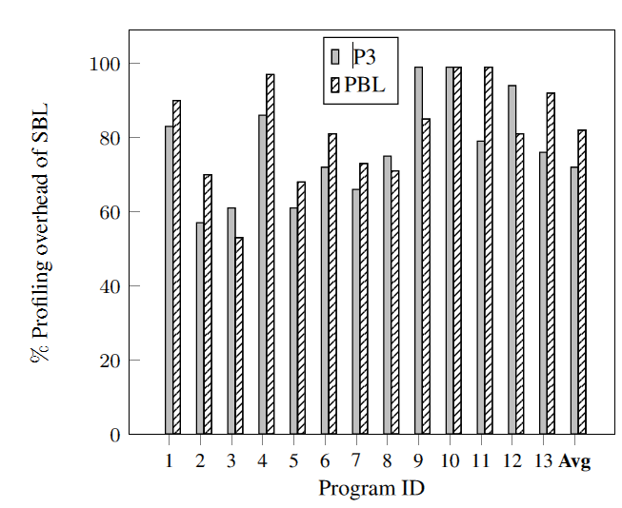
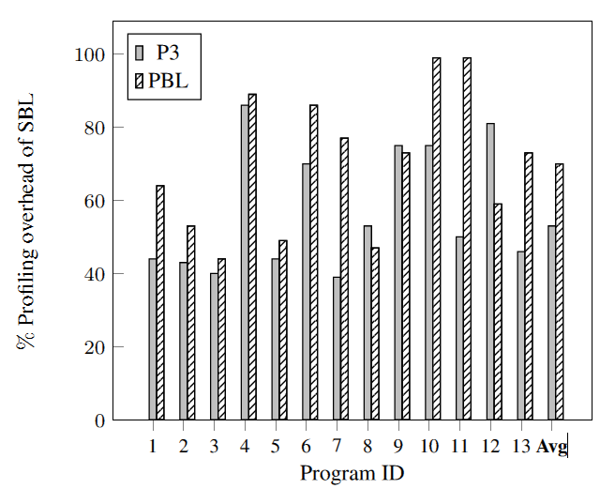
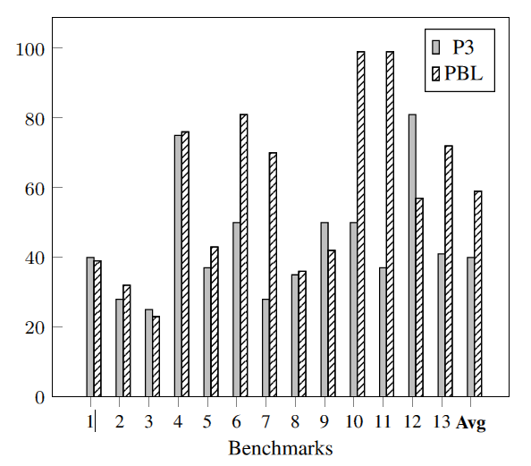
Experimental Results: P3 vs PBL vs SBL
2 core
4 core
Summary: Benchmark: SPEC 2006
Reduction (#cores)
SBL vs P3: 23% (2), 43% (4) and 56%(8)
PBL vs P3: 5% (2), 18% (4) and 25%(8)
Observation: In most cases P3 is better than PBL
Profitable procedure selection
Overlapping of probes
8 core

Slide 38
Practical constraints often present the scope for solving interesting problems which otherwise is not well-motivated

Slide 39
Automated Fault Localization

Slide 40
Fault Localization
Trace
Input
  Single failing test-case
Methodology for fault localization for incorrect output in some rows
  Differencing
    Compare passing and failing execution traces
  Single execution trace available
  Observation: In data-centric paradigm, programs loop over input data, operate on data per key value, output records per key value
  Solution: Compute dynamic slices with respect to correct and incorrect output
    Correct and Incorrect slices
  Compute difference between correct and incorrect slices
1 | 16.0
2 | 7.0
1 | 16.0
2 | 7.0

Slide 41
Technique Overview
Key-based Slice
&
Semantic
Differencing
Corner-
case
Mutability
Key-based Slice &
Sequence differencing
Slices still may be same, drill-down
inside the semantics to find differences
Field-Row Sensitive Slice
&
Sequence differencing
More precise the slices are,
more effective the differencing is

Slide 42
Field-Row Sensitive Slice
&
Sequence differencing

Slide 43
Example 1: Differencing of Slices
1
2
3
4
5
6
7
8
9
10
11
12
13
14
15
16
17
18
Select CustId ItemId Price Year from OrderTab into itab.
Select CustId Discount Year from DiscountTab into stab.
Sort itab by CustId, ItemId.
Delete from itab where Year <= CurrentYear – 2.
Loop at itab into wa.
At new CustId.
amount=0.
Endat.
amount = amount + wa.Price.
read stab into fa where CustId = wa.CustId.
if sy.subrc = 0.
  amount = amount - fa.Discount.
endif.
At end of CustId.
write wa.CustId, amount.
Endat.
Endloop.
OrderTab
CustId | ItemId | Price | Year
1 | Item1 | 10.0 | 2010
1 | Item2 | 10.0 | 2011
2 | Item3 | 10.0 | 2011
DiscountTab
CustId | Discount | Year
1 | 2.0 | 2010
2 | 3.0 | 2011
For each item
Output
Correct form:
for each customer
CustId | Amount
1 | 16.0
2 | 7.0
X
Expecting 18.0
1
2
6
7
8
10
11
12
13
15
16
1 | 16.0
2 | 7.0
X
6
10
11
12
13
X
1
2
6
7
8
10
11
12
13
15
16

Slide 44
Example 2: Motivation for Improvement in Slicing
1
2
3
4
5
6
7
8
9
10
11
12
13
14
15
16
17
18
Select CustId ItemId Price Year from OrderTab into itab.
Select CustId Discount Year from DiscountTab into stab.
Sort itab by CustId, ItemId.
Delete from itab where Year <= CurrentYear – 2.
Loop at itab into wa.
At new CustId.
amount=0.
Endat.
amount = amount + wa.Price.
read stab into fa where CustId = wa.CustId.
if sy.subrc = 0.
  amount = amount - fa.Discount.
endif.
At end of CustId.
write wa.CustId, amount.
Endat.
Endloop.
OrderTab
CustId | ItemId | Price | Year
1 | I1 | 10.0 | 2009
1 | I2 | 10.0 | 2011
2 | I3 | 10.0 | 2011
Correct:
< 2009
DiscountTab
CustId | Discount | Year
1 | 2.0 | 2011
2 | 3.0 | 2011
Output
CustId | Amount
1 | 8.0
2 | 7.0
Expecting 16.0
1
2
5
6
7
8
10
11
12
13
15
16
1 | 8.0
2 | 7.0
X
1
2
5
6
7
8
10
11
12
13
15
16
X

Slide 45
Need for a more Precise Slicing
1
1
X
1 | 8.0
2
2
2 | 7.0
X
5
5
Delete from itab where year <= 2009
itab
CustId | ItemId | Price | Year
1 | Item1 | 10.0 | 2009
1 | Item2 | 10.0 | 2011
2 | Item3 | 10.0 | 2011
6
6
7
7
8
8
Deletion of 1st row does not affect the correct slice
10
10
Deletion of 1st
row affects
the incorrect slice
Operation performed for CustId=1
Operation performed for CustId=2
11
11
12
12
13
13
Field-row sensitive slice will over-approximately add the delete statement in both the slices
15
15
16
16

Slide 46
Key-based Slice &
Sequence differencing
Field-Row Sensitive Slice
&
Sequence differencing

Slide 47
Key-based Slicing
Observation: In data-centric programs, data are selected based on
  Condition on key-fields (where conditions, at new/end)
  In sequence from a table (loop)
  Or both (e.g. group-by/order-by)
Key-Value Condition (KV)
  Is satisfied if the data change made by a statement matches the key-values of the elements used in the slice suffix
Adjacency Condition (ADJ)
  Is satisfied if the change made by a statement is adjacent to/in-between the elements (used in slice suffix) in a table
Change made by delete
statement
CustId | ItemId | Price | Year
1 | Item2 | 10.0 | 2011
CustId | ItemId | Price | Year
1 | Item2 | 10.0 | 2011
CustId | ItemId | Price | Year
1 | Item1 | 10.0 | 2009
1 | Item2 | 10.0 | 2011
2 | Item3 | 10.0 | 2011
KV Satisfied: <CustId,1>
ADJ Satisfied
CustId | ItemId | Price | Year
2 | Item3 | 10.0 | 2011
CustId | ItemId | Price | Year
2 | Item3 | 10.0 | 2011
KV Not satisfied: <CustId,2>
ADJ Not satisfied

Slide 48
Example 3: Motivation for Advanced Differencing
1
2
3
4
5
6
7
8
9
10
11
12
13
14
15
16
17
18
Select CustId ItemId Price Year from OrderTab into itab.
Select CustId Discount Year from DiscountTab into stab.
Sort itab by CustId, ItemId.
Delete from itab where Year <= CurrentYear – 2.
Loop at itab into wa.
At new CustId.
amount=0.
Endat.
amount = amount + wa.Price.
read stab into fa where CustId = wa.CustId.
if sy.subrc = 0.
  amount = amount - fa.Discount.
endif.
At end of CustId.
write wa.CustId, amount.
Endat.
Endloop.
OrderTab
CustId | ItemId | Price | Year
1 | Item1 | 10.0 | 2010
2 | Item3 | 10.0 | 2011
DiscountTab
CustId | Discount | Year
1 | 2.0 | 2009
1 | 3.0 | 2010
2 | 3.0 | 2011
Year is missing from join
Output
CustId | Amount
1 | 8.0
2 | 7.0
Expecting 7.0
1
2
6
7
8
10
11
12
13
15
16
1 | 8.0
2 | 7.0
X
1
2
6
7
8
10
11
12
13
15
16
X

Slide 49
Semantic Differencing
Sequence based differencing may not yield any difference between correct and incorrect slice
This is possible if a statement exhibits different behaviors in two slices due to nature of input data
  Semantic difference
We use two kinds of heuristics to find such semantic differences
  Corner-case differencing
  Mutability differencing
Key-based Slice
&
Semantic
Differencing
Mutability
Corner
case
Key-based Slice &
Sequence differencing
Field-Row Sensitive Slice
&
Sequence differencing

Slide 50
Corner-case Differencing
1
1
X
1 | 8.0
2 | 7.0
X
2
2
6
6
11: read stab into fa
where CustId = wa.CustId.
7
7
8
8
CustId | Discount | Year
1 | 2.0 | 2009
1 | 3.0 | 2010
CustId | Discount | Year
2 | 3.0 | 2011
11
11
12
12
Selects the lowest index row out of the multiple matching rows
13
13
Single row is matched
14
14
15
15
16
16

Slide 51
Corner-case Differencing
The semantic of a statement is classified into two separate categories: a normal case and one/more corner cases with respect to certain properties
Difference on the outcome of those properties
Most errors in tested code occur due to non-handling of corner cases that are revealed in the incorrect slice, and not in the correct slice
Notes:
If we drill down inside the semantics we can find out the two statements differ in paths.
To determine the difference, we classify the effect of the statement into normal or corner-case for a predefined set of properties.

Slide 52
Mutability Differencing
1
1
X
1 | 8.0
2 | 7.0
X
2
2
11: read stab into fa
where CustId = wa.CustId.
6
6
7
7
CustId | Discount | Year
1 | 2.0 | 2009
1 | 3.0 | 2010
CustId | Discount | Year
2 | 3.0 | 2011
8
8
11
11
11: read stab into fa
where CustId = wa.CustId and Year = wa.Year
12
12
13
13
CustId | Discount | Year
1 | 3.0 | 2010
14
14
CustId | Discount | Year
2 | 3.0 | 2011
15
15
16
16

Slide 53
Mutability Differencing
Mutability differencing tries to make an intelligent guess on the correct form of a statement in slice, such that the mutation
  produces different behavior of the statement than the observed behavior in the incorrect slice
  Preserves the behavior of the statement in the correct slice
The mutation considered are based on identification of the key-fields
Examples of mutation
  Similarity of field names in joining two tables
  Matching field names in sort and delete adjacent
  Matching field names in sort and at-new/at-end statement
  Matching field names in sort and binary search in read
Input
Input
S
S
Output
S
S
Output
Input
Input
S’
S’
Output’
Output

Slide 54
Experimental Results
13 Benchmark programs with real faults
Subjects | Field-row Slice size | Key Based Slice size | Corner case | Mutability | Missing | Time (secs)
RO13 | 8 | 8 |  |  |  | 23
IMAT | 4 | 4 |  |  |  | 20
IINV | 8 | 8 |  |  |  | 135
MMAT | 5 | 4 |  |  |  | 27
ORDER | 13 | 12 |  |  |  | 28
RLS | 4 | 4 |  |  |  | 1
ZROTC | 4 | 4 |  |  |  | 46
ZBMR | 5 | 5 |  |  |  | 4
ZQFPR | 8 | 8 |  |  |  | 1
ZFR052 | 4 | 4 |  |  |  | 1
BABL | 6 | 6 |  |  |  | 1
RV54 | 5 | 5 |  |  |  | 1
SUTAX | 12 | 12 |  |  |  | 2
Data
Fault
Field-row
sensitive slice,
Sequence
differencing
1
Semantic
Differencing
3
3
Key-based
Slicing,
differencing
X
X
Missing Rows
4
2
X
X
X
X
X
X
X

Slide 55
Automated Program Repair

Slide 56
Program Repair Overview
Debugging faults in database-centric applications is very tedious
We present an approach to correct bugs in selection conditions of database statements (Selection Bugs)
  Where clause of DB statements in ABAP (SAP) programs
  Key novelty is to use information latent in the data distribution to efficiently generate a correct repair
  First combination of semi-supervised learning (SVM) and combinatorial search (SAT) for repair
Notes:
Speaker notes:
Database-centric applications form the core of many enterprise systems. Debugging such programs is tedious since the code has a mix of both imperative and database centric logic and they typically deal with huge amount of data.
The approach that I am presenting today focuses on correcting a commonly found source of error in such programs – which are faults in the selection conditions of database statements. Specifically our problem domain is the ABAP language, which is a propriety language used in SAP applications.
Our key observation is that in typical failures of database programs on real world data, there is information latent in the distribution of data that could be leveraged to efficiently generate a repair suggestion which is very close to the intended manual fix.
Our approach presents a first-time combination semi-supervised learning enabled by Support Vector Machines and SAT-based combinatorial search in the field of repair
(1.5 mins)
-------------------------------------------------------------------------------------------------------------------------------------------------------------------------------------
Database-centric programs form the backbone of many enterprise
systems. Fixing defects in such programs takes much human effort
due to the interplay between imperative code and database-centric
logic. This paper presents a novel data-driven approach for automated
fixing of bugs in the selection condition of database statements
(e.g., WHERE clause of SELECT statements) – a common
form of bugs in such programs.

Slide 57
Example ABAP program
SELECT Customer Price Year from OrderTab INTO itab
SORT itab by Customer
DEL from itab where Year <= 2009 and Price > 5
LOOP AT itab INTO wa
AT NEW Customer
amount = 0
ENDAT
amount = amount + wa.price
AT END Customer
WRITE wa.Customer amount
ENDAT
ENDLOOP
DEL from itab where Year <= 2009 and Price > 5
itab
Customer | Price | Year
1 | 20 | 2012
1 | 16 | 2011
1 | 12 | 2001
1 | 10 | 2002
1 | 15 | 2011
2 | 7 | 2005
2 | 13 | 2007
2 | 15 | 2010
2 | 10 | 2011
3 | 4 | 2012
3 | 3 | 2009
3 | 9 | 2001
Label
+
+
-
-
+
-
-
+
+
+
+
-
Output Report
Customer ID | Order Amount
1 | 51
2 | 25
3 | 7
Customer ID | Order Amount
1 | 51
2 | 25 32
3 | 7
Passing key
Failing key
Passing key
About 25% of the code level bugs seem to be SELECTION bugs
Notes:
Here is an example of a typical program written in the ABAP language. As you can see it comprises of SQL-type statements such as SELECT which manipulate database tables and also imperative code that implements the business logic on the data to produce the output, which are typically reports for business users.
This specific program reads the customer ID, price and year of orders from an Order Table, subsequently deletes some records based on the Year and Price values. The loop that follows aggregates the price of orders corresponding to each customer and writes it out into a report. The output report displays the total amount corresponding to each customer ID. This is typical of the reports generated by database programs which display statistics grouped by certain key fields such as the customer-ID in this case.
A bug in such programs is detected when an end-user reports an error in the output report. These could be wrong values displayed for a particular customer or missing records. For instance, the user could report a bug saying that he expects to see a total order amount of 32 instead of 25 for customer 2. Bugs in production are usually due to subtle faults in the program, in that, they do not cause the output to be wrong for all keys. Like in this case, only a part of the report ,for customer 2 is wrong (which we refer to as the Failing key) while the outputs for customers 1 and 3 are as expected. We refer to them as passing keys.
Let us assume we had a fault localization scheme which indicated with high confidence tht the fault in this example lies in the Where clause of the DELETE statement which leads to wrong records being deleted from iTab table. The table on the right shows the records in itab input to the DELETE statement. The column Label shows the effect of the where clause condition on these records. Those labeled “+” are not DELETED and those with “-” are deleted from the table based on the existing condition. The bug in the condition causes wrong records to be deleted for customer ID 2, so the labels corresponding to customer 2 are wrong, which leads to a wrong final amount for customer 2.
25% of most ABAP code faults are due to wrong selection conditions of database statements known as SELECTION BUGS.
Correction of such bugs would involve determining an alternate Where clause that produces the expected output for failing keys (Cst ID 2) and maintain the same output for the passing keys.
(3.5)
---------------------------------------------------------------------------------------------------------
Prod bugs usually involve 1 line fixes. Caused due to certain data values not showing up during testing.
2. assume that the data in the input source on which the failing run executed is itself
consistent. That is, it does not violate its own integrity constraints. This assumption is reasonable,
because the same data-source typically feeds into several other applications that do work properly.
Hence the assumption is that the bug is always in the code—not in the data.
3. in the context of data-centric programs, we can leverage the fact that a single run of the
program yields an execution trace that can in turn be shredded into multiple independent slices,
each of which is responsible for a single record in the output. This is because these programs
typically loop over the input data records, aggregate the input depending on certain key fields and
generate an output record per key value.
4. Usually in a
data centric program, as part of the output record, you do write out an input field that acts as the
identifier (or key) for the data and is unchanged from the input to output.
----------------------------------------------------------
ABAP- Advanced Business Application Programming
TBD:
1. Color imperative declarative parts

Slide 58
Program Repair challenges
Even if location of the bug is known finding the correct condition is tedious
  Generation of variants
    Simple mutations: ex. boundary conditions (+/- 1) … do not cover all types of faults
    Search in program space very time consuming: Numerous ways of altering the Where clause
      Year [ <, >, <=, >=, =] [2000,…., 2009] (all distinct values under Year column)
      Price [ <, >, <=, >=, =] [0..,20] (all distinct values under Price column)
      Possible inclusion/deletion of fields, comparison with variables .. so on
  Validation is time consuming
  Condition needs to work for passing keys as well and be globally valid
Notes:
Even if it is know that the bug lies in the Selection condition, determining the correct condition is challenging.
1. A naïve technique is to apply simple mutations covering common bugs such as wrong boundary conditions, corrected by adding + or -1 to constant values or changing < to <= so on. But these do not cover a huge range of possible bugs
2. Searching in the space of all possible syntactic variants to the Where clause would be very time consuming. This is specifically because the space of conditions which involve data constants is huge (since typically there are 1000s of possible distinct numeric values in database tables)
Secondly, since the only oracle of correctness available is the final program output, validation of each possible variant would involve running the entire program to generate the final output
Further, we need to ensure that the condition works both for failing and passing keys and is generalizable to future unseen inputs
(1 min)

Slide 59
Insight 1: Search in data-space should be faster than search in program-space
Assuming we had correct labeling for all the rows, then, we can quickly learn the correct WHERE clause from the data
Notes:
Our first insight was that the data profile of failures in database programs is quite potent. There is typically large amount of data with sufficient diversity andalso a single execution slice contains data for which the program passes and also data for which it fails. Hence mining the dataspace could give us clues to discover the correct condition faster than searching for possible variants in the program space.
So.. Our hypothesis
( 0.5 min)
-------------------------------------------------------------------------------------------------------------------

Slide 60
Background: Classifiers
Classifier is a function that assigns discrete labels to data points
  Where clause is a typical example of a 2-class classifier (labels +/-)
Supervised learning
  Discover a classifier based on pre-labeled data (training)
  Generalizable: high accuracy on unseen data
  Decision-tree learning generates compact classifiers in terms of the data attributes
  compact classifiers are more generalizable
  generates conditions expressible as disjunctions of clauses
  deals with large data efficiently
Notes:
A where clause can be considered as a classifier on the data
JUST READ:
(1.5 min)
--------------
Compact classifiers would be more generalizable to unseen data since they would not be overfitted to training data

Slide 61
Decision Tree Learning
Hill-climbing approach which inductively builds a tree
  Each level performs a test on an attribute that splits the data into groups
  Repeat splitting until every group contains only 1 type of label
  Paths leading to label of one type represent the corresponding classifier
  Attribute which provides maximum information gain is chosen for the split
Customer | Price | Year
1 | 20 | 2012
1 | 16 | 2011
1 | 12 | 2001
1 | 10 | 2002
1 | 15 | 2011
2 | 7 | 2005
2 | 13 | 2007
2 | 15 | 2010
2 | 10 | 2011
3 | 4 | 2012
3 | 3 | 2009
3 | 9 | 2001
+
+
-
-
+
+
-
+
+
+
+
-
+
+
-
-
+
+
-
+
+
+
+
-
Split on Year >= 2008? Gain = 0.92 – 0.3 = 0.62
Year >= 2008
true
false
…
…
Notes:
Decision tree learning inductively builds a tree in the hypothesis space
At each level of the tree a test is performed on an attribute which splits the data into smaller groups. The splitting is continued until every group contains labels of only 1 type. The paths leading to a label of a particular type represents the classifier for that type.
In order to keep the decision tree compact / to generate a compact classifier, the attribute that is chosen to perform the split is important.
A greedy algorithm is adopted wherein the attribute that gives the maximum information gain is chosen to perform the split.
Information gain is defined as the amount of reduction in the uncertaining of labeling in the dataset defined as the entrophy of the dataset, after the split is performed.
Conceptually what this means is that we want to choose an attribute, a test on which divides the dataset into groups, s.t. every group maximally contains labels of one type. For the given dataset, such a test would be Year >=2008, which splits the data into 2 groups, one of which contains all positive labels and the other contains max of negative labels except just 1 record. The rationale is that,
the number tests required to distinguish this one record from the others would be less , hence the overall classifier would be small in size
(1.5 min)

Slide 62
Decision Tree for our example
Year >= 2008
true
false
OR
Customer | Price | Year
1 | 20 | 2012
1 | 16 | 2011
1 | 15 | 2011
2 | 15 | 2010
2 | 10 | 2011
3 | 4 | 2012
3 | 3 | 2009
+
+
+
+
+
+
+
Customer | Price | Year
1 | 12 | 2001
1 | 10 | 2002
2 | 7 | 2005
2 | 13 | 2007
3 | 9 | 2001
-
-
+
-
-
Price >= 8
AND
true
false
Year >= 2008 OR Price < 8
DEL from itab where Year <2008 AND Price >=8
Customer | Price | Year
1 | 12 | 2001
1 | 10 | 2002
2 | 13 | 2007
3 | 9 | 2001
-
-
-
-
Customer | Price | Year
2 | 7 | 2005
+
DEL from itab where Year <= 2009 AND Price > 5
Notes:
For our example, such a test would be Year >=2008, which splits the data into 2 groups, one of which contains all positive labels and the other contains max of negative labels except just 1 record. The rationale is that,
the number tests required to distinguish this one record from the others would be less , hence the overall classifier would be small in size
As expected, a test on Price is able to sieve out the +vely labeled record.
The conjunctions of tests on each path that leads to a + label, and the disjunction of such paths is the classifier.
In this case this reduces to Year >=2008 or Price < 8.
For the DELETE statement, this represents the records that should not be DELETED, so the corrected Where clause, would be its complement, i.e. Year < 2008 AND Price > = 8, which is the desired repair.
On comparing with the original incorrect clause, though the condition on Year could have been corrected by +/-1 mutations, the correction on price is non-trivial to arrive at , without considering the data for analysis.
---------------------------
****The main advantage of this approach is that
the data coverage of variants is utilized to choose one over the other and also to guide further mutations. As
against this, while searching merely in the program space, only the binary decision of whether a particular
program variant yields the correct output or not is considered. – END?

Slide 63
How to find correct labels?
Cst ID | Price | Year
1 | 20 | 2012
1 | 16 | 2011
1 | 12 | 2001
1 | 10 | 2002
1 | 15 | 2011
2 | 7 | 2005
2 | 13 | 2007
2 | 15 | 2010
2 | 10 | 2011
3 | 4 | 2012
3 | 3 | 2009
3 | 9 | 2001
+
+
-
-
+
b₁
b₂
b₃
b₄
+
+
-
Constraint solving using SAT
b₁ ? 7 : 0 + b₂ ? 13 : 0 + b₃ ? 15 : 0 + b₄ ? 10 : 0=32
Solution: b₁ = 1, b₂ = 0, b₃ = 1, b₄ = 1
Cst ID | Price | Year
1 | 20 | 2012
1 | 16 | 2011
1 | 12 | 2001
1 | 10 | 2002
1 | 15 | 2011
2 | 7 | 2005
2 | 13 | 2007
2 | 15 | 2010
2 | 10 | 2011
3 | 4 | 2012
3 | 3 | 2009
3 | 9 | 2001
+
+
-
-
+
b₁
b₂
b₃
b₄
+
+
-
+
+
-
-
+
+
-
+
+
+
+
-
+
+
-
-
+
-
+
-
-
+
+
-
45% surcharge if Year < 2010 and Price > 10
b1 ? 7 : 0 + b2 ? 13 + 19 : 0 + b3 ? 15 : 0 + b4 ? 10 : 0 = 32
Solution1: b1 = 0, b2 = 1, b3 = 0, b4 = 0 <or>
Solution2: b1 = 1, b2 = 0, b3 = 1, b4 = 1
Blowup in search space as # of records increase
More than 1 correct labelings possible
  Labeling is crucial in determining quality of the Where clause learnt
Notes:
In order to apply the decision-tree learning technique, we need to first determine the correct labels for the records of the failing key, or the state after the faulty statement that would lead to the correct final output.
For the passing keys , we could assume that the existing labels are correct. We could represent the label for each failing key record by a boolean variable which takes a true value if the record is selected and false value if not.
This represents a typical constraint solving problem, which could be represented by the following formula, for our example. Wherein the price values of those records, whose corresponding boolean vars are true, are aggregated and equated to the expected output of 32. SAT –solver is employed to efficiently search through the combinatorial possibilities to arrive at the valuation which results in the final output. For our case, the solution assigns a negative label to record with price 13 and year 2007 and the remaining records for cst id 2 are given +ve labels.
However, the search space increases exponentially with the number of records, which can choke the SAT-solver.
Further, there can be more than 1 possible solutions or more than 1 labelings that give the correct final output.
For instance, in our example, suppose a surcharge was selectively added to the price values of records with Year < 2010 and Price > 10. For customer ID 2, this would lead to the addition of $19 if the record with price 13 and year 2007 were to be selected.
In such a case, b2=1, rest 0 is another solution that would give a total amount of 32.
The Where clause learnt from each of these solutions would give the correct the final output for the given input, but they would be very different from each other in form, How do we choose a solution that yields a Where clause that is closest to the manual fix or is correct on other unseen inputs too.
-------------------------------------------------------------------------------
7 + 15 + 10 = 32
7 + 13 + 12

Slide 64
Insight 2: Where clauses classify regions of data uniformly, so failing key records similar to passing key records should have same labels
We can guess the labels for incorrectly labeled data based on its spatial proximity with (larger amounts of ) correctly labeled data
Notes:
Our second insight was that , A WHERE condition typically classify regions of data uniformly, as opposed
to cherry picking points in the data space and classifying them individually
by some complex conditional logic. So, records that are similar to each other, would in most probability have the same behavior for the Where clause. Hence failing key records that are similar to passing key records should mostly have the same labels.
So our second hypothesis was that .. read

Slide 65
SVM based predictions on our example
Customer | Price | Year
2 | 7 | 2005
2 | 13 | 2007
2 | 15 | 2010
2 | 10 | 2011
Prediction
-
+
+
+
Confidence
0.3
0.2
0.9
0.9
Labels
-
+
+
+
1. Rely on predictions completely
15 + 10 + 13 ≠ 32
Customer | Price | Year
2 | 7 | 2005
2 | 13 | 2007
2 | 15 | 2010
2 | 10 | 2011
Prediction
-
+
+
+
Confidence
0.3
0.2
0.9
0.9
Labels
-
b₁
+
+
2. Relax the label on the row with lowest confidence of prediction
Notes:
Our algorithm starts by completely relying on the predictions to assign labels to the failing rows. As can be seen , this does not lead to the correct final output, which indicates that the predictions are incorrect for one or more rows.
As the next step, we use the confidence values to guess which of the rows might have incorrect predictions and relax the labels on those rows alone. In this case the second row has the lowest confidence value of 0.2, so a boolean var is introduced for this row alone.

Slide 66
Iterative SAT solving
Customer | Price | Year
2 | 7 | 2005
2 | 13 | 2007
2 | 15 | 2010
2 | 10 | 2011
Prediction
-
+
+
+
Confidence
0.3
0.2
0.9
0.9
Labels
-
b₁
+
+
Labels
b₁
b₂
+
+
Labels
+
-
+
+
b₁ ? 13 (+19) : 0
+ 15
+ 10
= 32
b₁ ? 7 : 0
+ b₂ ? 13(+19) : 0
+ 15
+ 10
= 32
Use of Predictions
b₁ ? 13 : 0
+ 15
+ 10
= 32
b₁ ? 7 : 0
+ b₂ ? 13 0
+ 15
+ 10
= 32
Helps reduce the search space for SAT (16 to 4)
In practice, make do with < 10 symbolic variables as opposed
to ~100 …)
Chooses b1 = 1, b2 = 0, b3 = 1, b4 = 1 Year >= 2008 or Price < 8
over
b1 = 0, b2 = 1, b3 = 0, b4 = 0 Year > 2006 and (Price < 10 or > 15 or ( (Price > 10 and <= 15 ) and ((Year > 2005 and < 2007) or > 2010))
Notes:
SAT is now called to solve for the boolean var b1, which basically checks if a total sum of 32 can be obtained by assigning a negative label to the first record, positive labels to the last 2 records and either including or not including the second record. This is not possible.
So we again iteratively relax the label on the rows with the next lowest confidence value (i.e record 1) and invoke SAT again. This time a solution is obtained , which assigns a –ve label to the 2nd record and positive labels to the rest of the rows.
Hence, by iteratively introducing boolean variables guided by the based predictions , we were able to reduce the search space for SAT, though it may be small for this example. We found that in real cases, the predictions were mostly accurate, leading to the use of < 10 vars in place of ~100 vars.
Also, notice that even if the logic were to allow the other solution of b2 being 1 and others 0, the labeling guided by predictions chooses the solution which gives the most natural Where clause that is closest to the manual fix.
The classifier generated from the other solution is very overfitted to the data on hand and would not be generalizable to any other input.
This adds proof to our hypothesis that labeling failing key rows based on their spatial proximity to passing key rows closely mimics what should have happened ideally as intened by the user.

Slide 67
Tool Chain
Data-spectra of a failure holds information that can guide the repair
SVMLight
Correctly
labeled
“Passing”
rows
Transductive learning
Predictions for
“Failing” rows
Constraint-solving
(for low confidence labels)
Alloy-Kodkod-MiniSAT
Correct
labels for
all rows
Decision
Tree
WHERE
suggestion
ID3
(homegrown impl)
Notes:
To summarize, our key insight is that the data-spectra of a failure (i.e.) distribution of data for passing and failing keys (analogous to test-spectra) holds information that can guide the repair.
Our approach leverages this information to first determine the correct state after the faulty statement and then determine an alternate Where clause that generates this state.
We use support vector machines (SVM Light) in transductive learning mode to predict the labels for failing key rows based on passing key row labels.
We start by completely relying on the predicted labels and if not valid, iteratively relax our trust in the labels and employ SAT to search for the correct labels. We model the ABAP code in the Alloy language (which is based on first order relational logic), the Kodkod model finder is used to translate the problem into boolean logic and employ the MiniSAT solver to handle the combinatorics.
Once the correct labels for the failing key records are found, we feed the data and labels for both passing and failing keys to a homegrown ID3 Decision tree learning algorithm, which generates the Where suggestion or the repair.

Slide 68
Conclusions
Summary
  Get execution trace efficiently
  Find faults
  Repair them automatically
Wisdom from Industry Research:
  Practical constraints often present the scope for solving interesting problems which otherwise is not well-motivated
  In industry we often have to wear two hats – a researcher’s hat and a practitioner’s hat
~Thank You~

